Slide 1
Reading at Camp School
KS1
Led By:
Shabnam Sultan Year 1 Class teacher
Rachel Rowe (Deputy Head and Year 1 class teacher)

Slide 2
How is reading taught at Camp School?
1:1 Reading
Phonics
Guided Reading
Whole Class Reading
English sessions

Slide 3
1:1 Reading and book bands
Coloured book bands - each band covers a set number of graphemes
Should feel easy – 95-100% accuracy
Some bands take longer for children to move from – does not mean they are not making progress
Aim to read a book 3 times in the week – decoding, fluency and comprehension

Slide 4
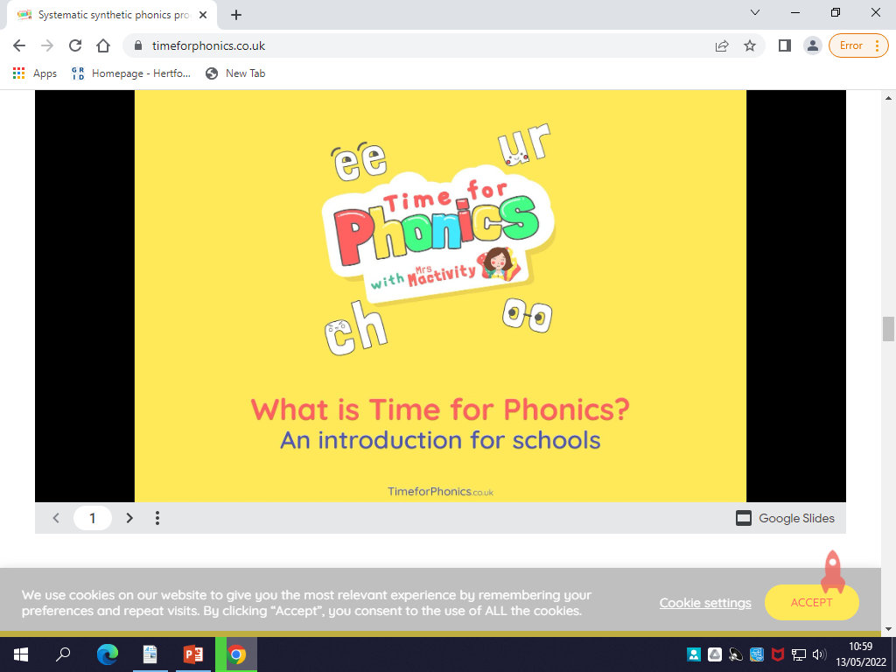
Phonics
Taught in Phases:
Nursery – Phase 1
Reception – Phase 2
Phase 3
Phase 4
Year 1 – Phase 5
Year 2 – Recap phase 5 but focus on spelling patterns and decoding strategies for reading.
Scheme:
Approach:
Practical
Games
Multi-sensory

Slide 5
Phonics vocabulary
Phase: A section of learning within the phonics programme
Phoneme: The smallest unit of sound made in a word - “a”, “s”
Grapheme: The letters used to write the sound
Digraph: two letters make one sound “ai” and “ea”
Trigraph: three letters make one sound “igh” and “air”
Split vowel digraph: where the digraph is split to make the sound “i_e” – bike, kite
Segmenting: Splitting words into their sounds h-a-t (may hear children refer to as sound buttons as we draw these under the words)
Blending: putting the sounds together to make a word h-a-t says hat

Slide 6
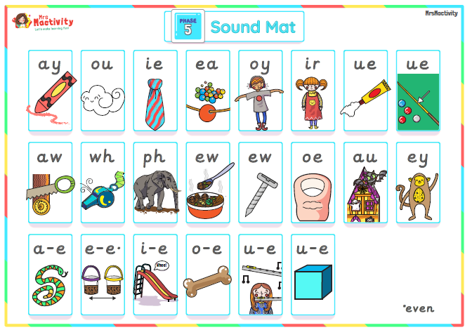
Year 1
In Year 1, the focus is on the children learning the phase 5 sounds.

Slide 7
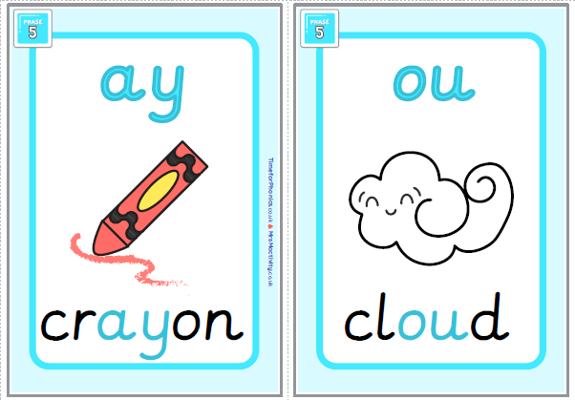

Slide 8
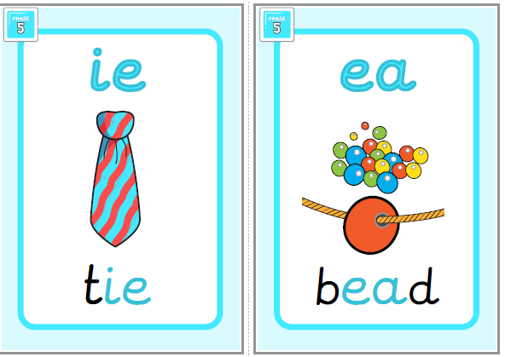

Slide 9
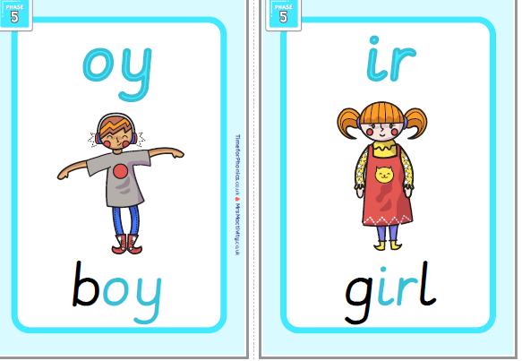

Slide 10
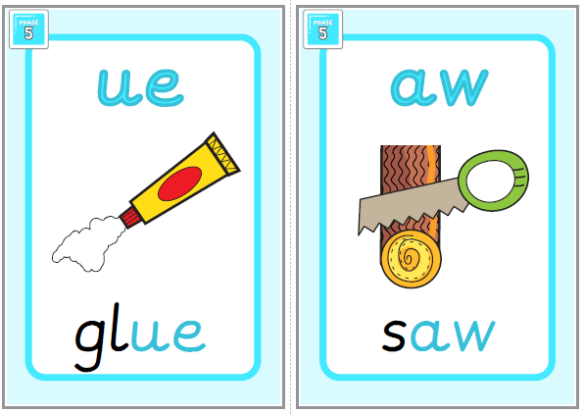

Slide 11
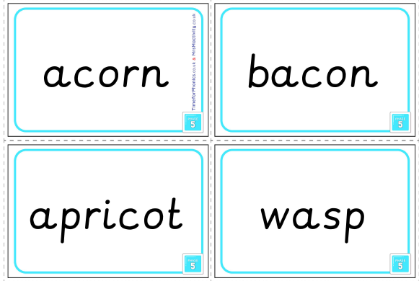
Alternative pronunciations

Slide 12
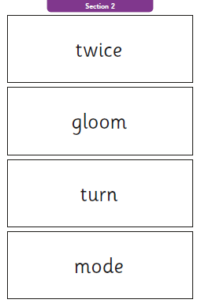
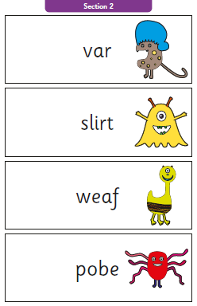
Phonics Screening

Slide 13
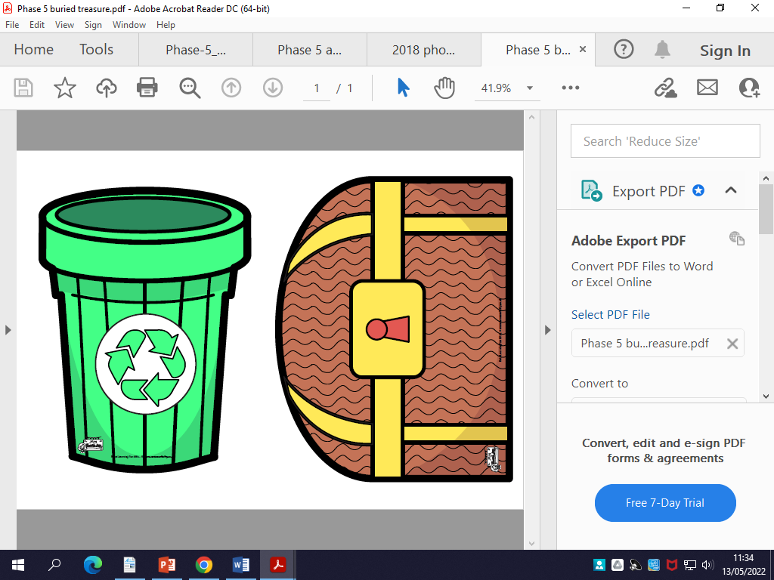
Activity

